Slide 1
Vue.js
Adding interactivity
Forms, two-way data binding, events

Slide 2
Starter code
Start with these two files - make copies on your computer
student_sign_in.html https://github.com/claraj/vue-week-2-starter-composition/blob/main/student_sign_in.html
styles.css https://github.com/claraj/vue-week-2-starter-composition/blob/main/styles.css
Finished code here, for reference only https://github.com/claraj/vue-week-2-composition
Live site https://claraj.github.io/vue-week-2-composition/student_sign_in.html

Slide 3
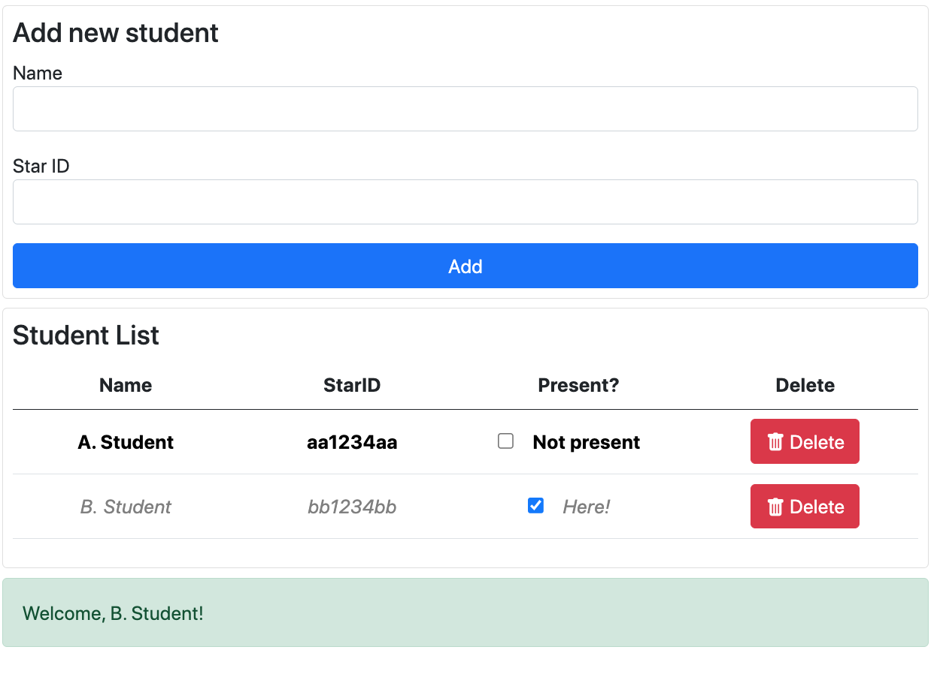
Student sign-in page – finished app features
Show a table of student names and their StarID
Can add a student – name and StarID are required
Check the box by the student's name in the table to sign in/out
Welcome and Goodbye message as students arrive and leave
Can delete a student

Slide 4
Most of the HTML is written for you
Uses Bootstrap, but Bootstrap is not necessary for Vue
Only to make the page look a little nicer, for example, tables and alerts
You'll create the Vue app and complete the template/view
Look for the TODO comments in the HTML template

Slide 5
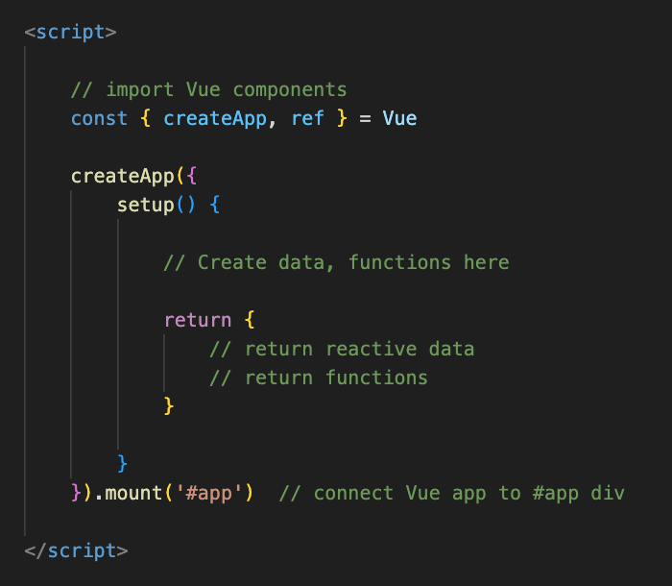
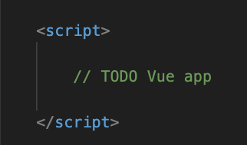
Create new Vue app
At the bottom of student_sign_in.html, Look for this part of the page
Replace
// TODO Vue app
with this ->

Slide 6
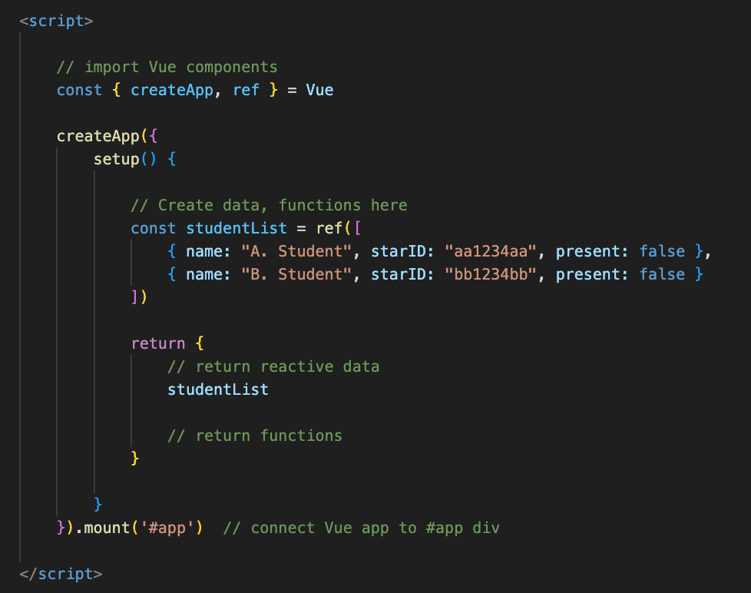
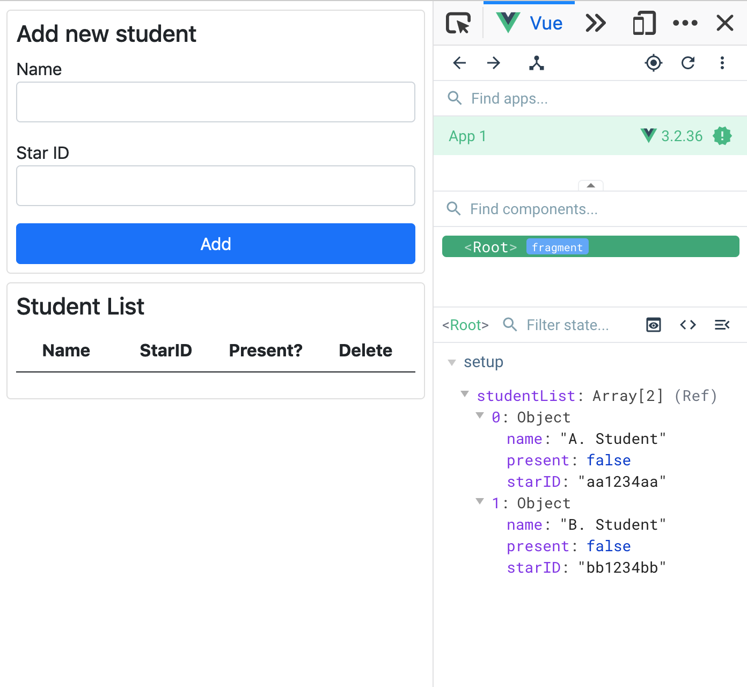
Student Data
Create some data with an array of example student objects in a studentList reactive ref

Slide 7
Student Data
Do you see the data in the Vue dev tools?

Slide 8
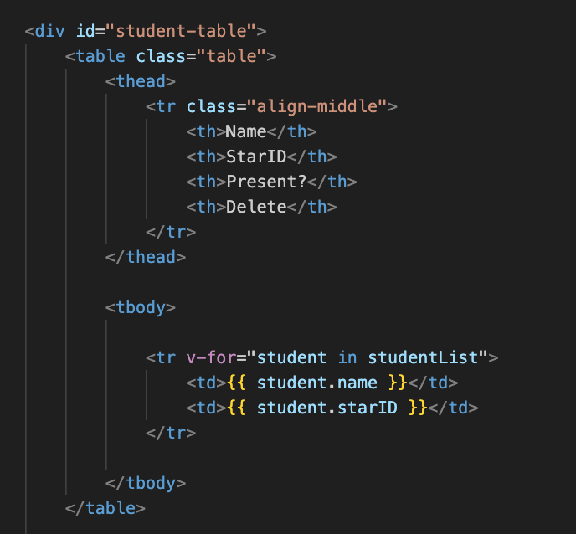
Displaying data in table
Find the table element, around line 40
Add a new tr element
Use v-for to iterate over studentList and display info for each student
Each student object has a name and starID property
Can access object properties in template

Slide 9
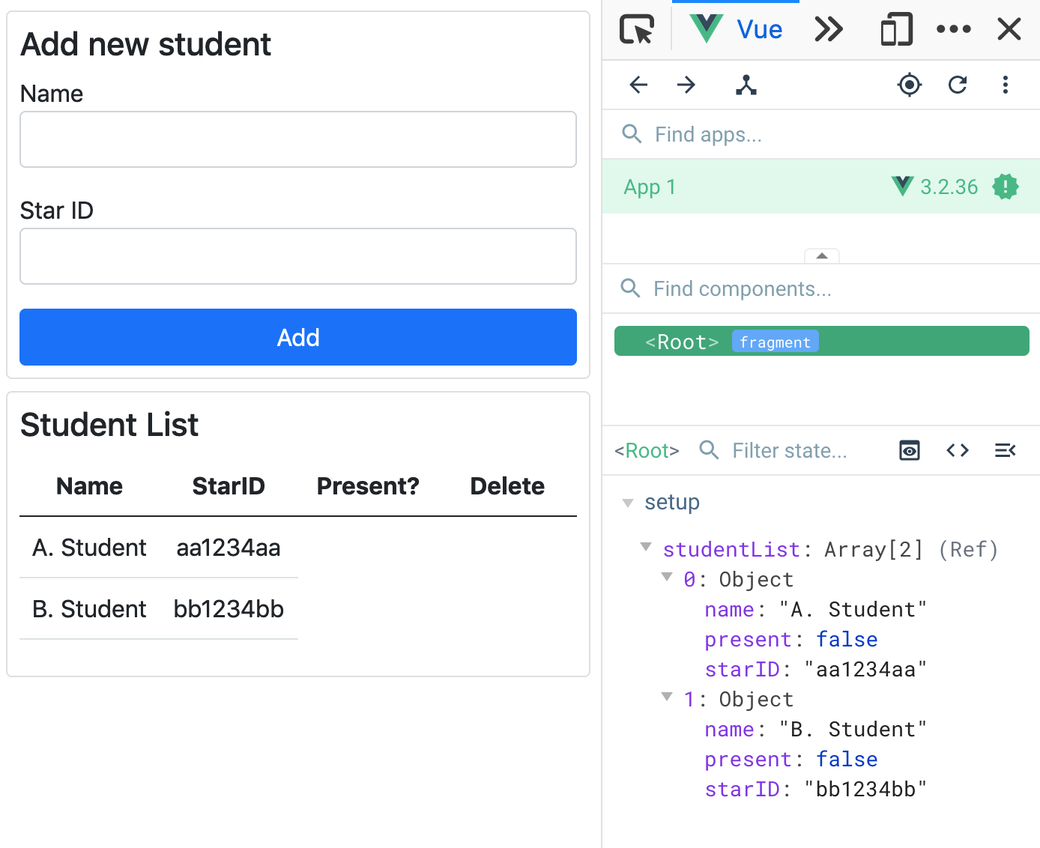
Name, starID in table
The data in the template matches the data in dev tools
We'll add the checkboxes and delete button soon

Slide 10
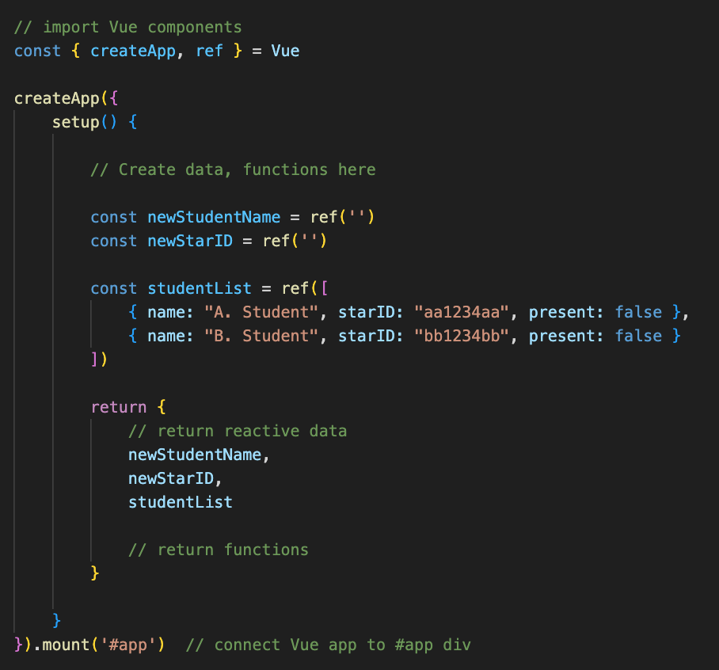
Adding new student
Add two new ref properties to Vue, newStudentName and newStarID
These will be linked to the name and star ID inputs using v-model
So, the app will be able to read what the user has typed into the inputs

Slide 11
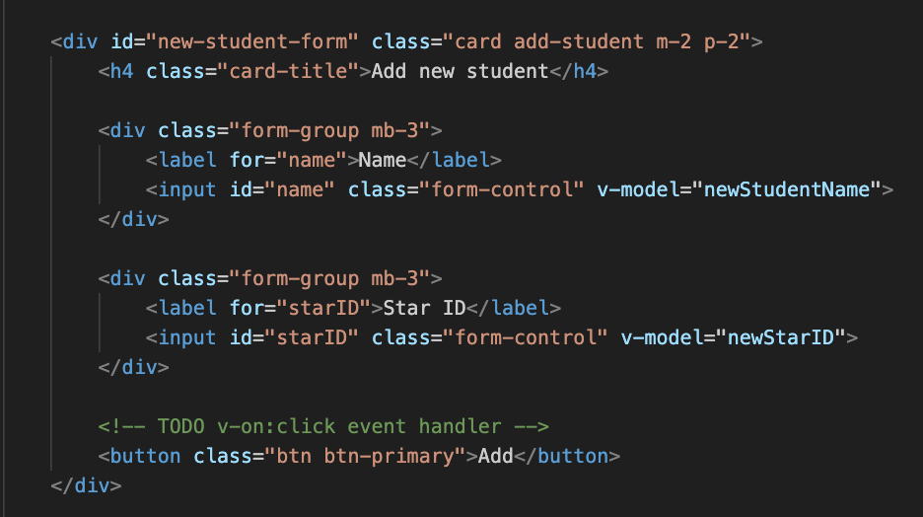
v-model - connect newStudentName and newStarID
Find the form
Add v-model attribute to each input

Slide 12
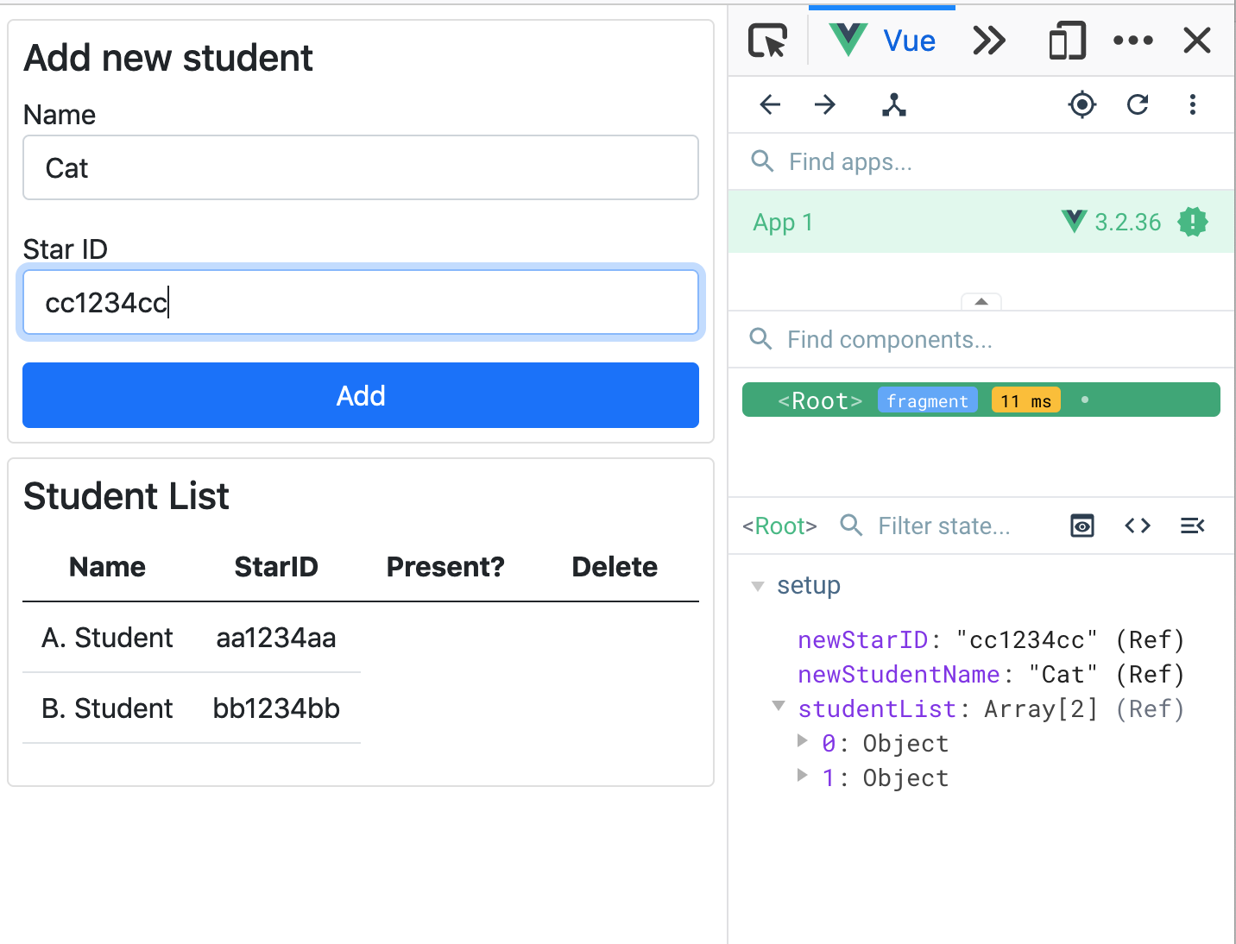
Check in the Vue dev tools
Type some text in the Name and Star ID inputs
Look for the text you typed in the Vue data

Slide 13
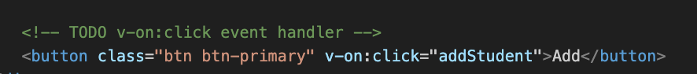
Connect the add button
Need the Vue app to respond to the button click event
Find the button, and add v-on:click attribute to call addStudent function

Slide 14
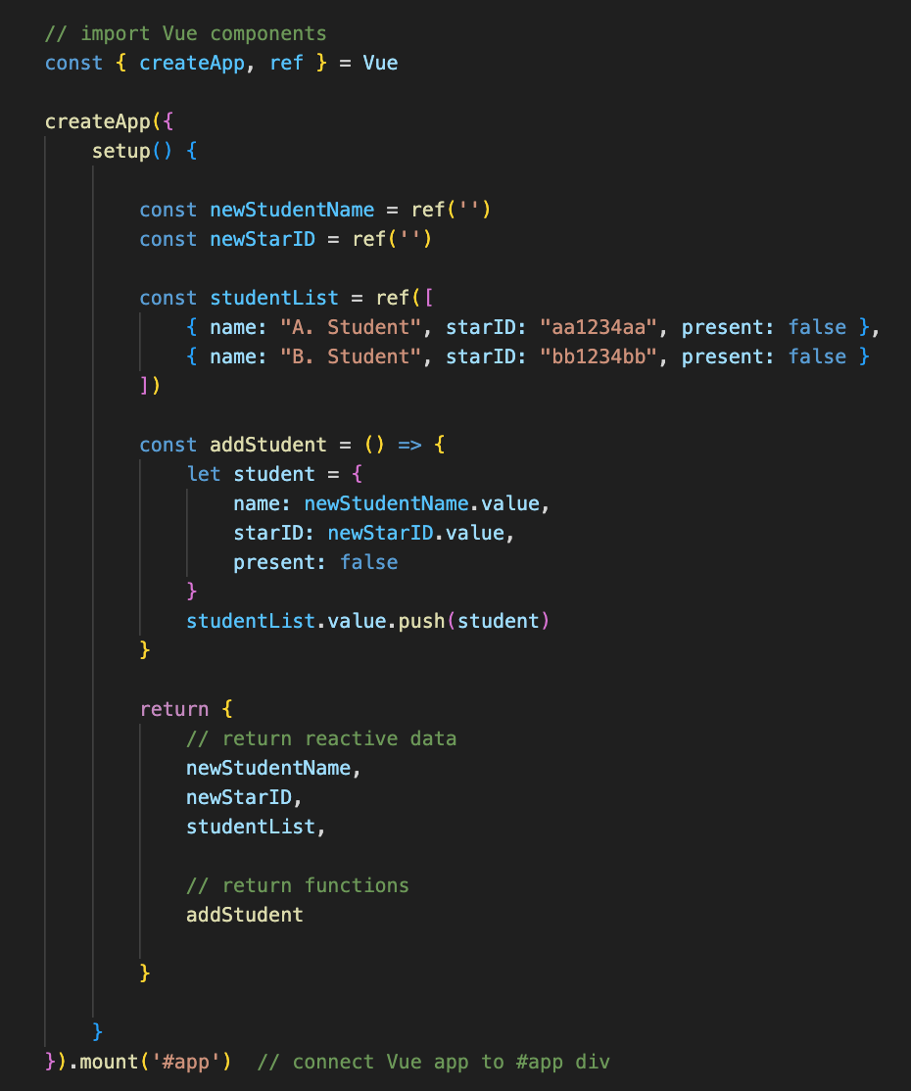
addStudent function
Define addStudent function, add it to the returned object
Make new student object from the values of the newStudentName and newStarID data
push onto the end of the studentsList array
Be careful to use the exact property names in the new student object: name, starID and present

Slide 15
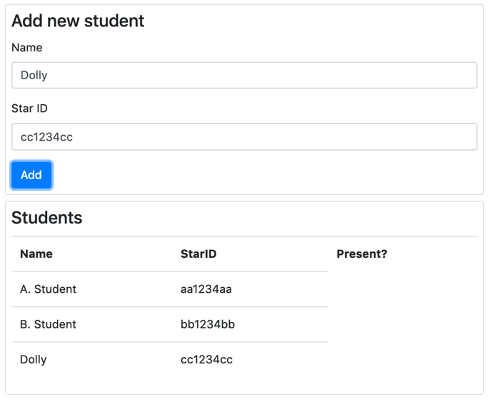
Run and test
Can add new students
Two issues:
No validation, can add students with no name/StarID, duplicate starIDs
Added students' info stays in the form, user will have to delete the text to add a new student

Slide 16
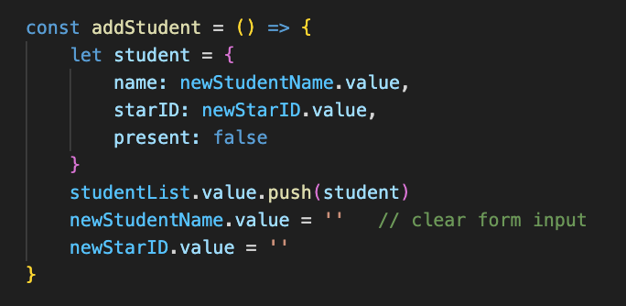
Remove info from form after adding student
Set the newStudentName.value and newStarID.value to empty strings
v-model creates two-way data binding
If the form changes, the data in the app updates
And if the data in the app changes, the form updates
Both are set to two single quotes - an empty string

Slide 17
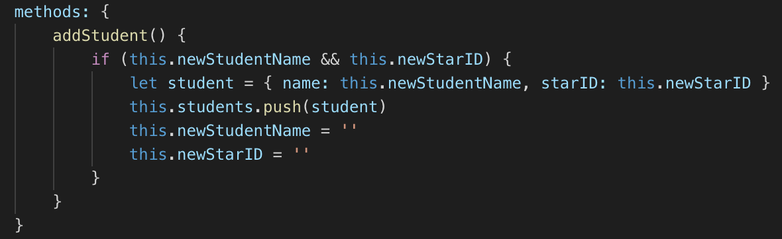
Basic Validation
Check that the name and the StarID are both entered
Empty strings are false in JavaScript

Slide 18
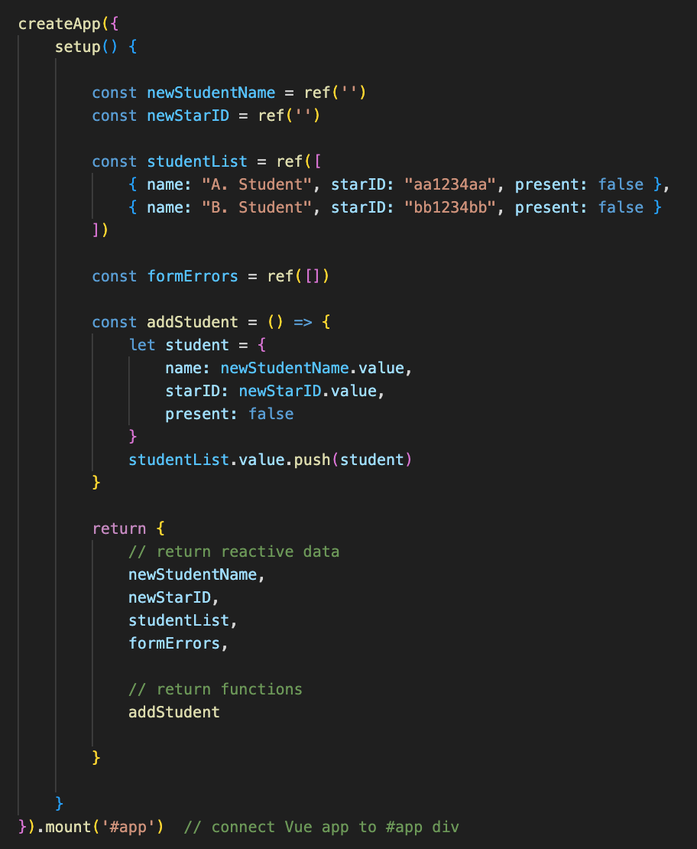
Error messages
Feedback for the user if there is an error in the form
Add formErrors property, an empty array
Add to returned object

Slide 19
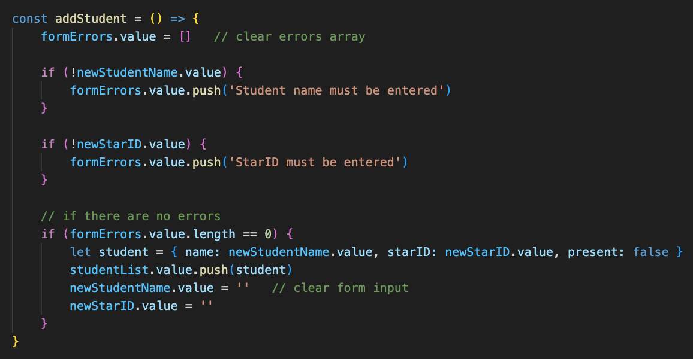
Validation
Clear formErrors first
Check each form input, add message to formErrors if data is not valid
Check length of formErrors and ensure it is 0 before adding new student

Slide 20
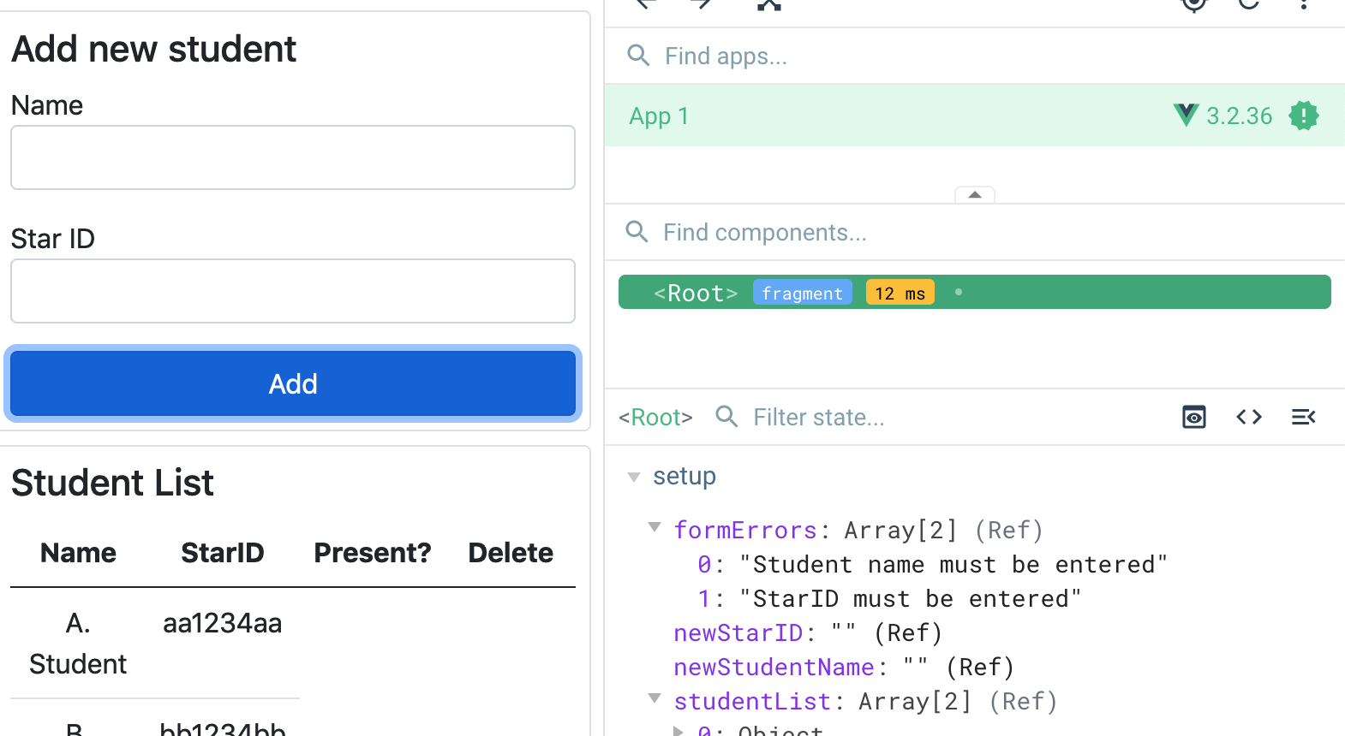
Form Errors
Try clicking Add with no name or no starID or neither
Watch Vue dev tools
formErrors should clear if name and starID are entered

Slide 21
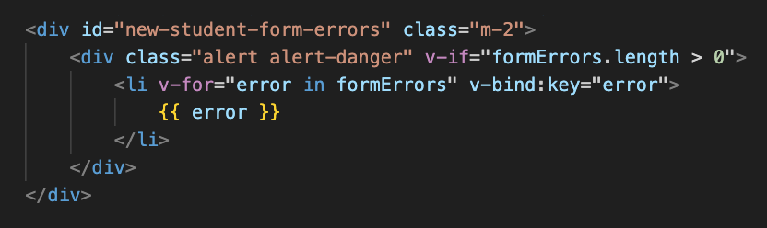
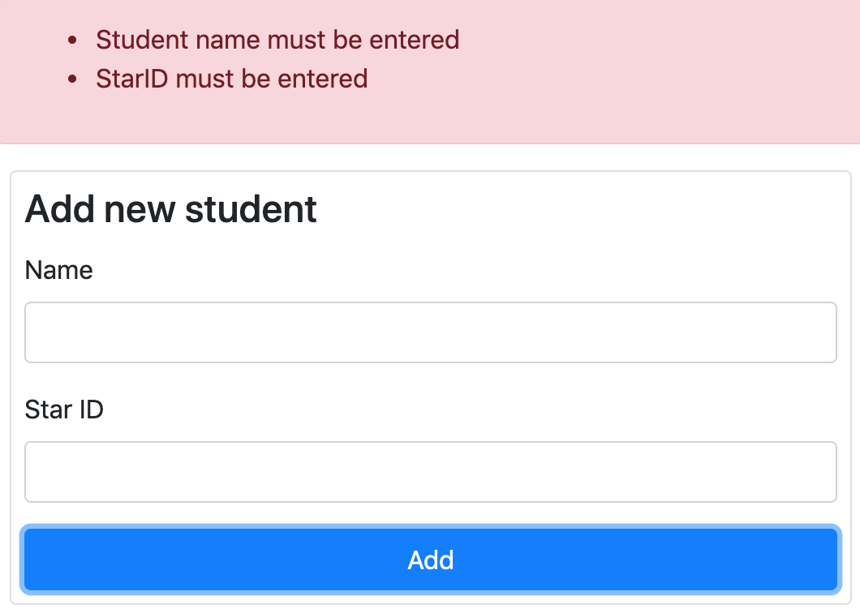
Display error messages in template
Only show errors if the formErrors array has more than 0 elements
Use v-for to display one li element for each error
The alert alert-danger classes are from Bootstrap, for displaying the red/pink colors

Slide 22
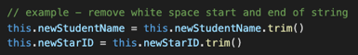
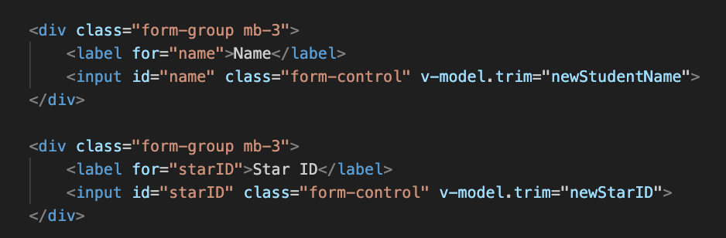
Validation with .trim – trimming whitespace
Try entering spaces for a name and StarID
A new student with name = " " could be added
We could remove in the addStudent method e.g.
Better: Vue can help with the .trim modifier
Type spaces into the inputs, watch the value in Vue devtools

Slide 23
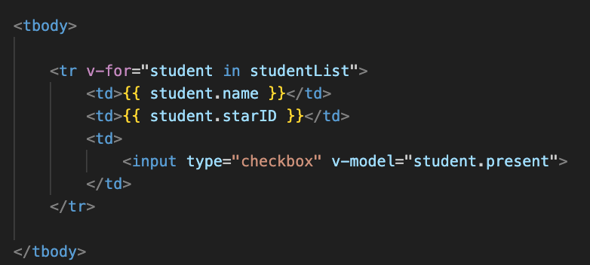
Student present/absent checkbox
Modify the template – add a checkbox to each table row
v-model="student.present"
Run and test – should see checkbox on each row

Slide 24
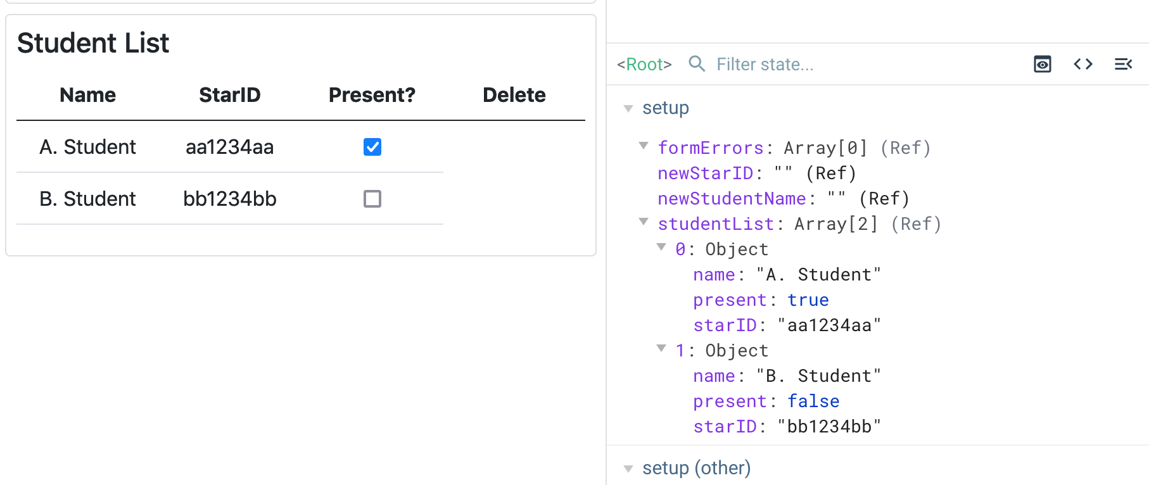
Checkboxes look at dev tools
Check and uncheck the checkboxes
Data updates in dev tools

Slide 25
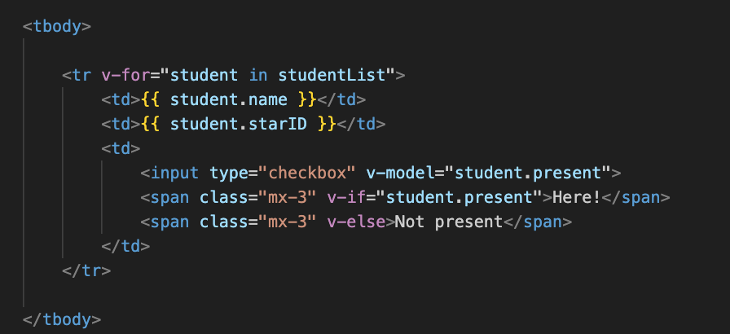
Add a message
Extra feedback for user
Uses v-if and v-else

Slide 26
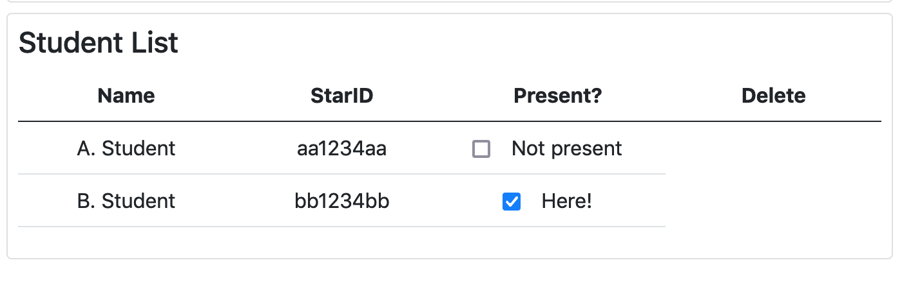
Test in browser
Data is staying in sync

Slide 27
Welcome message
Would like to see a 'Welcome' message for the most recent student to sign in
When a student leaves, show a 'Goodbye' message
Can add a v-on:change event handler that calls a function when the checkbox is changed (checked or unchecked)

Slide 28
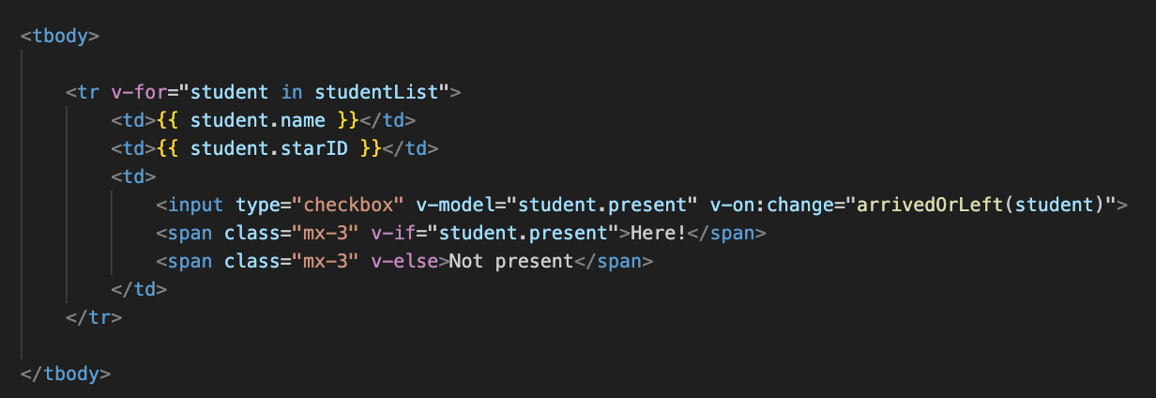
Modify checkbox
Add v-on:change to the checkbox input
Event handler functions can be called with arguments
arrivedOrLeft function can take an argument – in this case, the student object the row is for
So, we can tell who arrived, or left

Slide 29
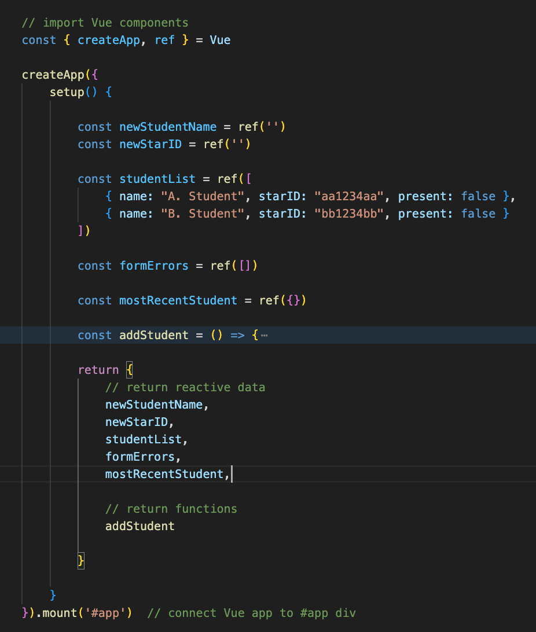
New Data - mostRecentStudent
Add new data attribute, mostRecentStudent
Will hold an object, a copy of the most recent student to arrive or leave
This function is collapsed, don't delete it

Slide 30
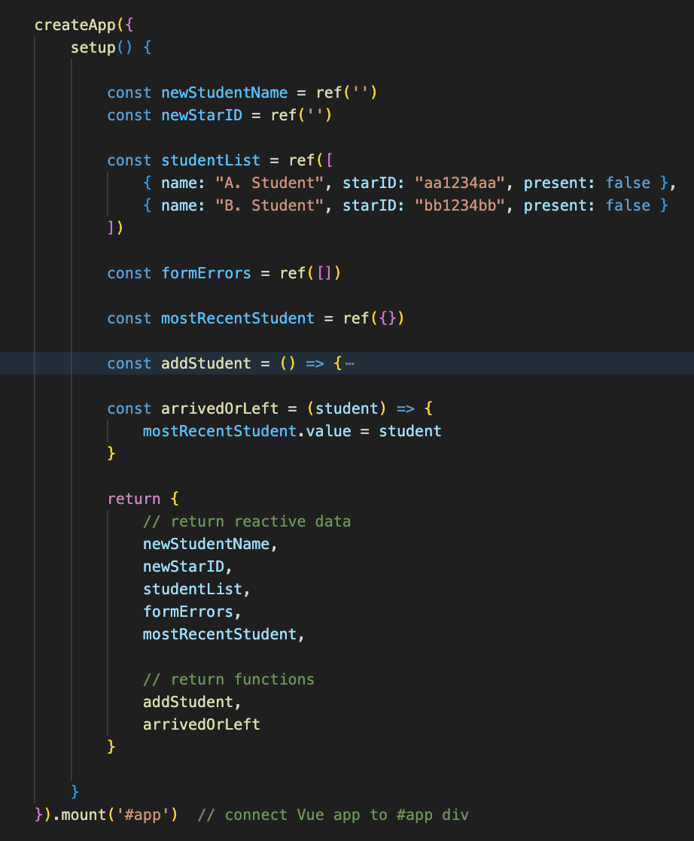
Add arrivedOrLeft(student) function
Run and test, check and un-check students
Look at the new mostRecentStudent property in dev tools

Slide 31
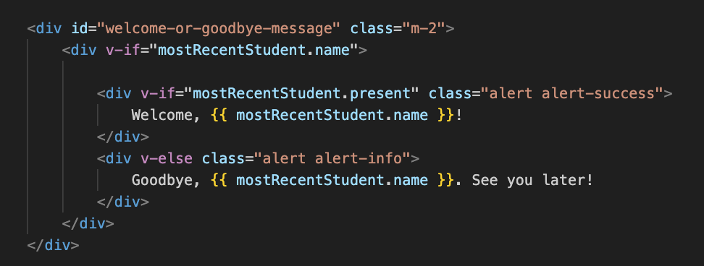
Display message in template
v-if Show <div> if there is a mostRecentStudent.name
Within this div, use v-if and v-else to decide what message to show
v-if If mostRecentStudent.present, show welcome message
v-else Else, show goodbye message

Slide 32
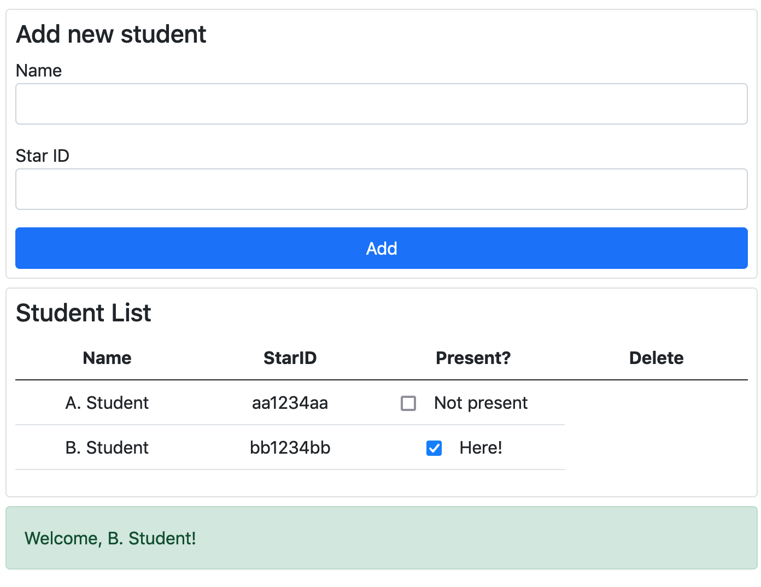
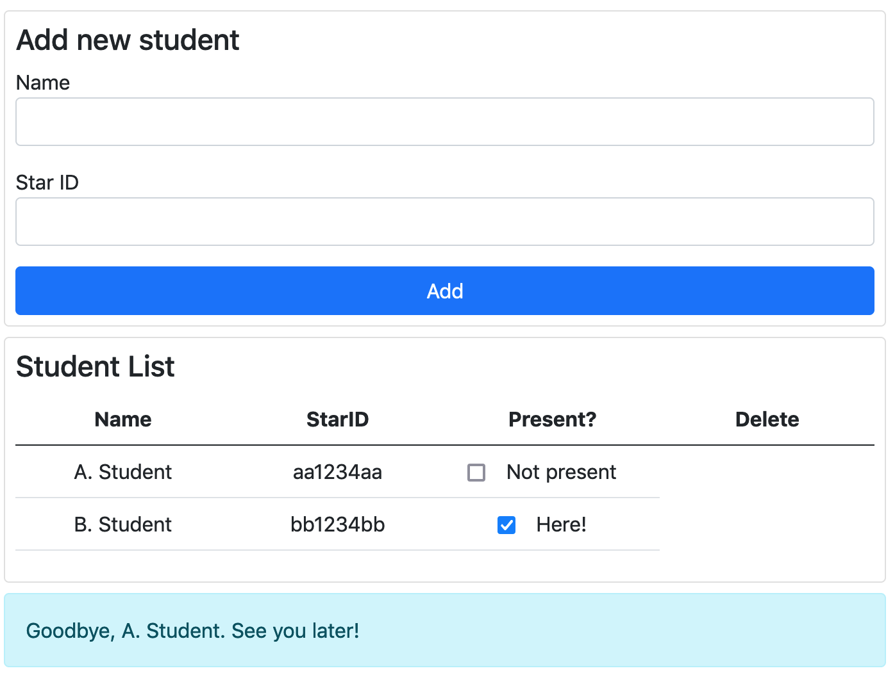
Display message in template
Test by checking and unchecking the checkboxes in the table
In the screenshots, B. Student arrives; A. Student leaves

Slide 33
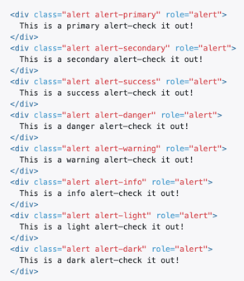
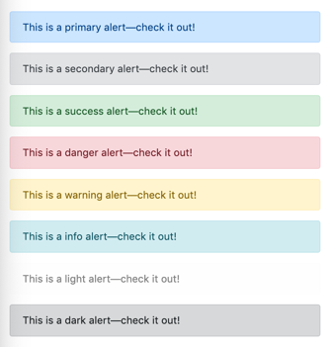
Optional: choose different color alerts for welcome and goodbye messages
https://getbootstrap.com/docs/5.0/components/alerts/

Slide 34
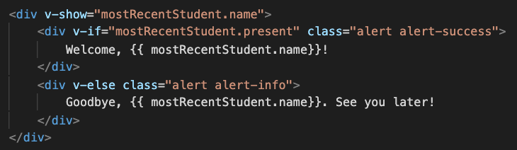
v-if and v-else
Elements are added, or removed from DOM based on the truth of the expression after v-if
So, if mostRecentStudent.name is true, the welcome div element is part of the DOM
If mostRecentStudent.name is false, the welcome element div element is removed (or not added) to the DOM; the goodbye element is added

Slide 35
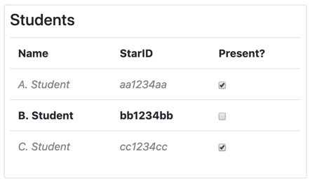
Setting styles with Vue
Display present, and absent students using different styles
Make it easier to differentiate who is here and who isn't
For students who need to sign in, use styles to make their names more prominent so easier to find
Use v-bind:class to set the class element for each row, depending on if a student is present or not
Easier for B. Student to find their name, if their name is bold.
A. Student and C. Student are already here so their names are gray.

Slide 36
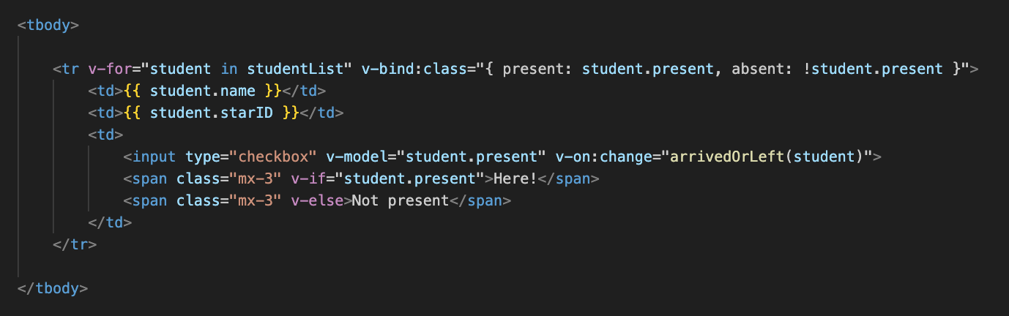
Setting styles based on Vue data
Use v-bind:class, the value is an object
The present class is added to this <tr> if the value student.present, is true
The absent class is added to this <tr> if the value !student.present, is true

Slide 37
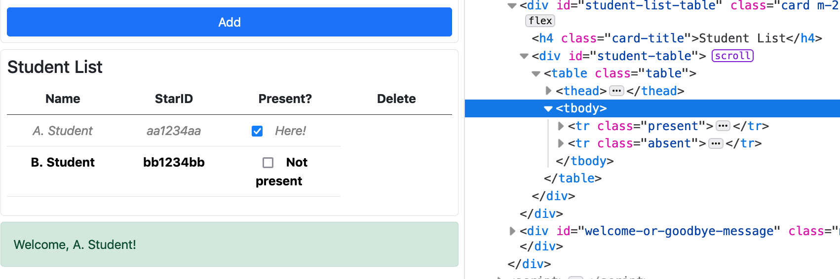
Setting styles with Vue
These styles were provided in styles.css
Test in browser, change styles if preferred
Note classes added to HTML

Slide 38
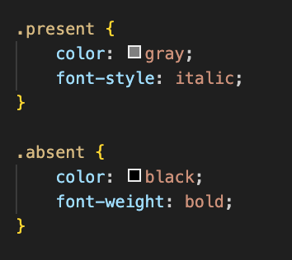
styles.css
Use your own style(s) for .present and .absent if preferred

Slide 39
v-for and v-bind:key
Vue is reactive, and if the number of students changes, or the data about one student changes, the HTML is changed
By default, Vue will re-draw the entire table, and this can be quite slow
Often, only a small amount of data has changed so only a small part of HTML needs to be updated - it would be more efficient if Vue could figure out what part of the HTML needs to be changed
v-bind:key is used to associate a unique piece of data, with each HTML item generated with v-for
For example, the starID for each student should be unique
When something in the list changes, Vue can identify exactly which piece of HTML needs to change, and only change that
So, using v-bind:key is optional, but makes page updates faster for larger data sets

Slide 40
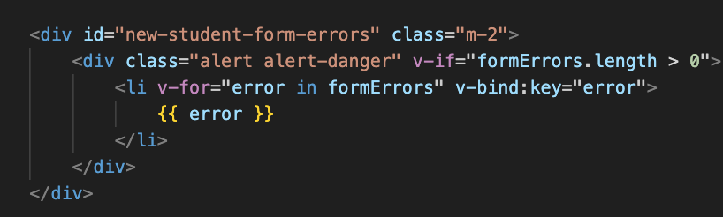
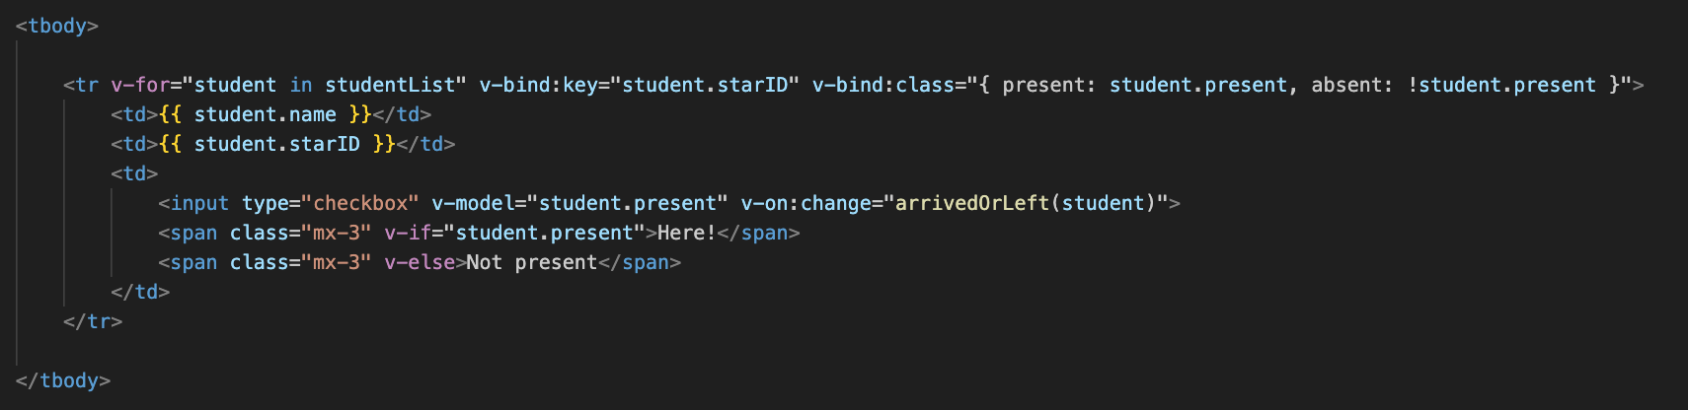
Adding v-bind:key
Errors list - error message as key
Student table, student starID as key

Slide 41
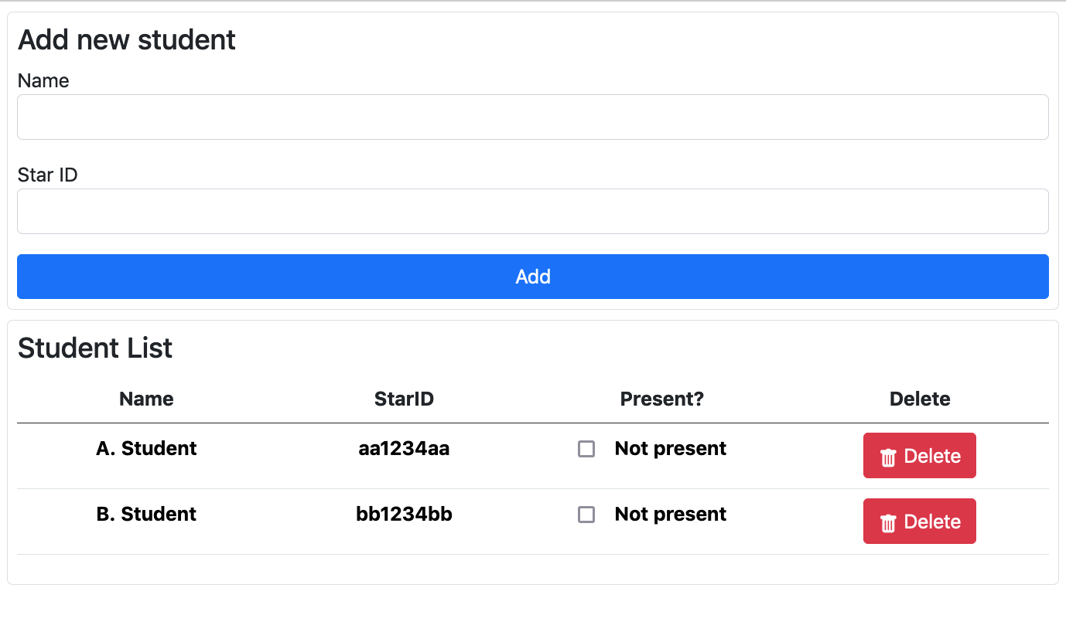
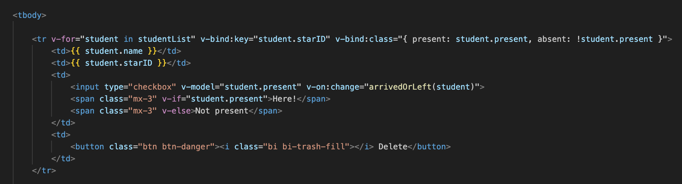
Deleting a student
Add delete button with icon to row
Uses Bootstrap icon from https://icons.getbootstrap.com/
This library was added to the HTML, see head element
https://icons.getbootstrap.com/icons/trash-fill/

Slide 42
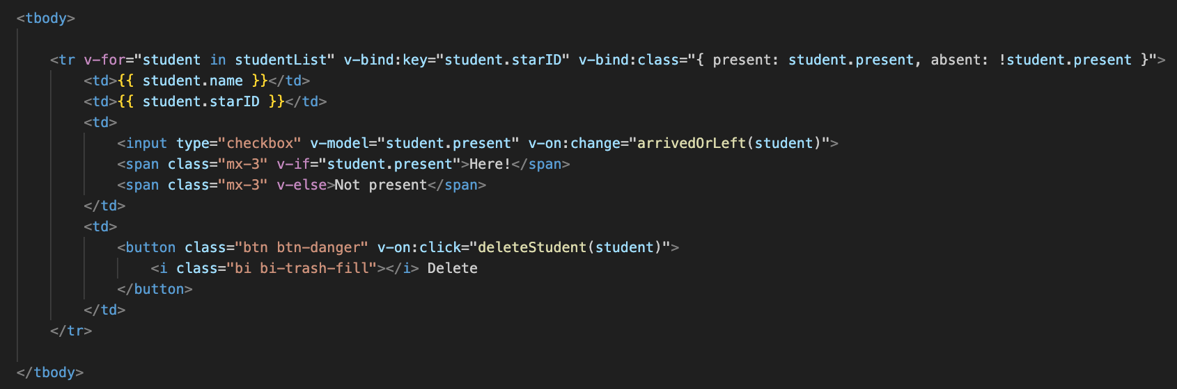
Events
Add v-on:click and call deleteStudent function, passing student object as an argument
We need to write the deleteStudent function

Slide 43
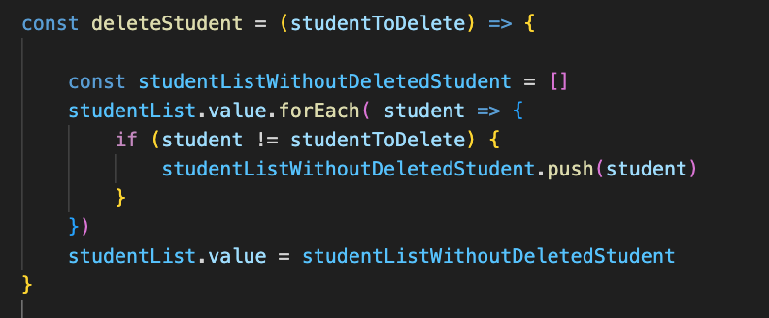
deleteStudent - things we've already seen
Make new array
loop over existing students, check each student
If this isn't the student to delete, add it to new array
So, the student to delete won't be added to the new array
Replace the studentList value with the new array

Slide 44
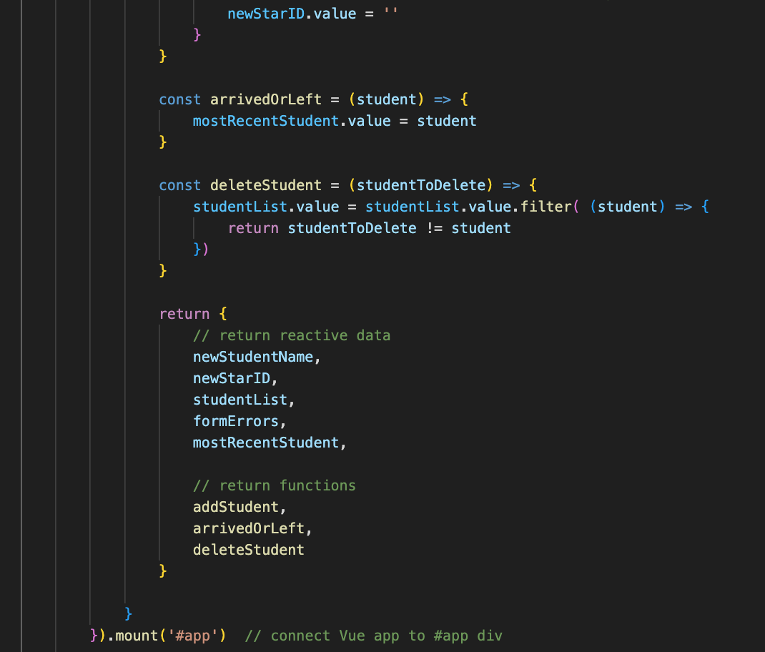
deleteStudent
Alternative - use filter function to filter out the studentToDelete
Add delete student function, add to return object
Run and test

Slide 45
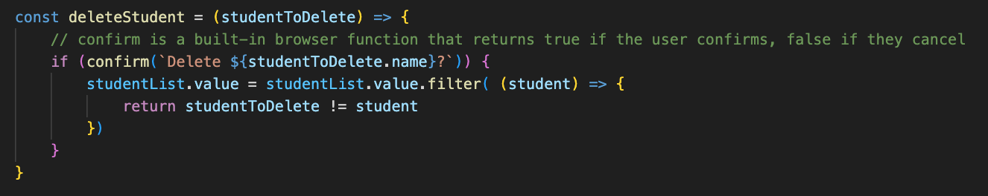
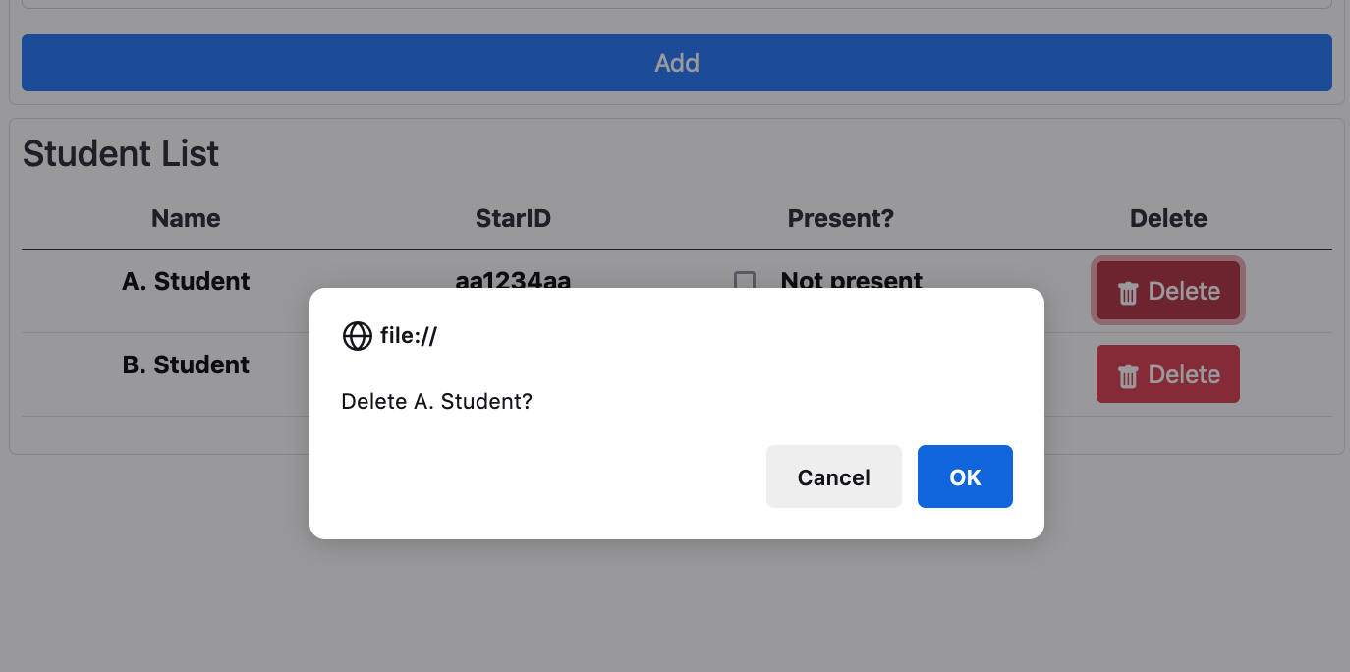
An "are you sure" message would be good
Better user experience, harder to accidentally delete a student
Use the browser confirm function

Slide 46
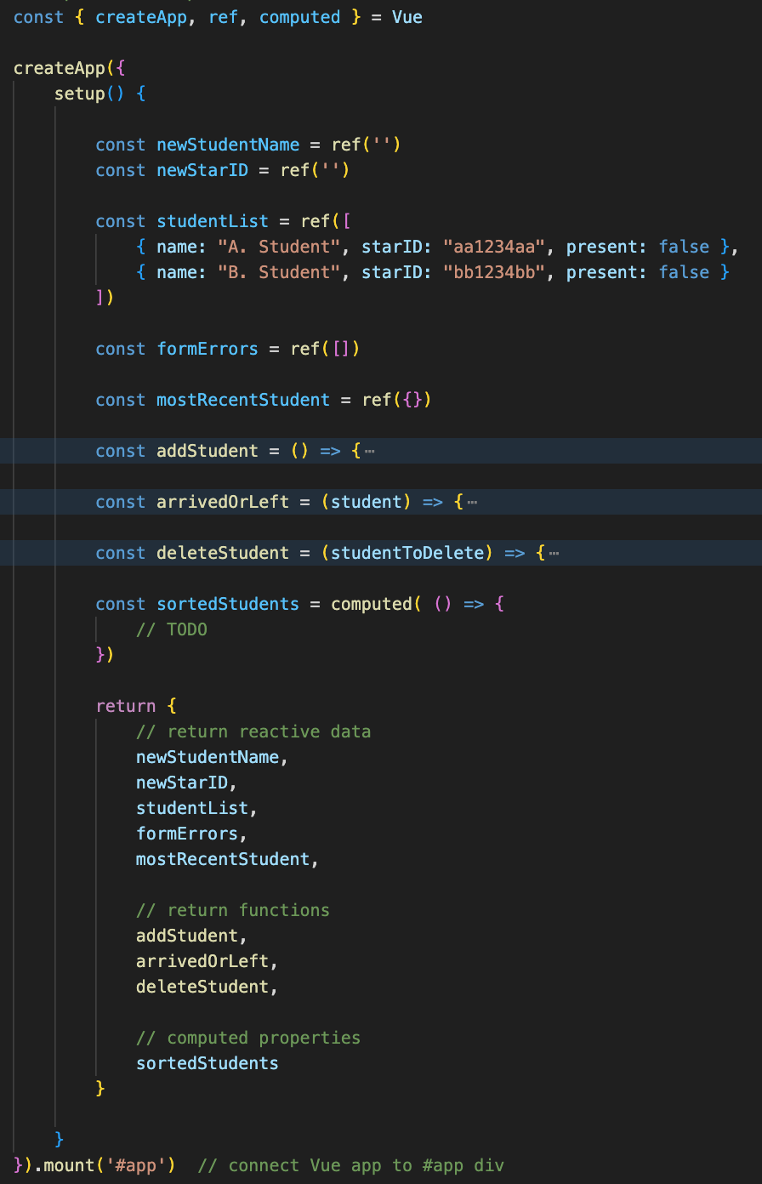
Sorting students in alphabetical order
Our app can keep the students in the order they were added
But it can present the students in alphabetically order by using a computed property
Add computed to the imports, new computed property, add to return object

Slide 47
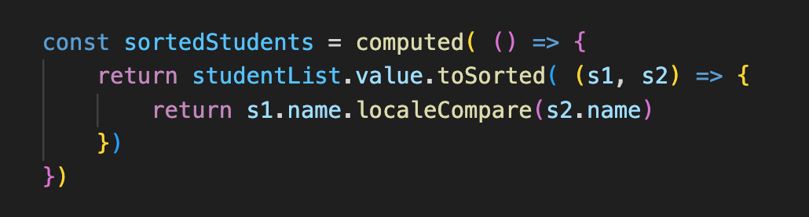
Sorted student list computed property
How do we decide if one student is before, or after another one in a list?
localeCompare function returns a value that indicates if a string is alphabetically before, after, or equivalent to another string

Slide 48

In table, replace studentList with sortedStudent
Test, observe in dev tools

Slide 49

In table, replace studentList with sortedStudent
There are now two lists
studentList still adds new students to the end
The app displays the sorted version of the list

Slide 50

How many students in the class?
Another computed property, studentCount

Slide 51

Display in template

Slide 52

Test
Verify number matches the number of students, try adding and deleting students
Bonus question - can you display a message "1 student in class" or "3 students in class" with the correct plural student or students

Slide 53
@ shortcut
Can replace v-on with @
Optional: try it out in your project

Slide 54

v-bind shortcut
v-bind is the most common Vue directive
If you omit it, but keep the : then Vue assumes you mean v-bind
Optional: try it out in your project
Example: this was v-bind:class

Slide 55

v-bind vs v-model
v-bind is one-way
sets HTML attributes, text for data
If data changes, attributes/text are updated
v-model is two-way
modify element, data changes. Modify data, element changes.
Used for forms, input

Slide 56
Make sure everything is working
Please ask for help if not - happy to help you troubleshoot

Slide 57
Lab in D2L
Thank you!

